Slide 1
EE602: Algorithms
Unconstrained Gradient Descent
Beemnet Alemayehu

Slide 2
Gradient descent
Best fit line for set of points minimizing some function
This function depends on the objective of the fit
Various ML have objectives and constraints not linear
GD general method for finding local minimum of function f: R^{r}->R
Local min x is f(x) ≤ f(x’) for all x’ near x
Convex function (local min == global min)

Slide 3
Formal definition
Defn: measure of steepness of various directions
Given f: R^{n} -> R, ∇f is R^{n} -> R^{n} comprising n partial derivates
∇f (x) = ∂f/∂x₁, ∂f/∂x₂ … ∂f/∂x_{n}
f(x^{t+1}) ≤ f(x^{t})
The two main details are the initial point and how far to move in the direction of negative gradient

Slide 4
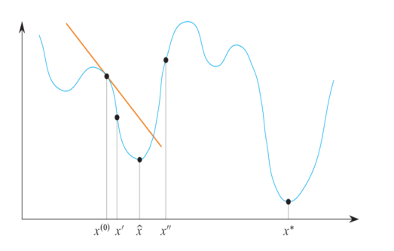
Unconstrained GD
Let’s start by looking at unconstrained gradient descent in one dimension
f : R -> R
∇f is f’(x), derivative with respect to x
The complexity of computing the gradient depends on the function f and can sometimes be expensive
Figure 1. A function f : R➔R, shown in blue. Its gradient at point x⁽⁰⁾, in orange, has a negative slope, and so a small increase in x from x⁽⁰⁾ to x' results in f(x') < f (x⁽⁰⁾). Small increases in x from x⁽⁰⁾ head toward X̂, which gives a local minimum. Too large an increase in x can end up at x", where f(x") > f(x⁽⁰⁾). Small steps starting from x⁽⁰⁾ and going only in the direction of decreasing values off cannot end up at the global minimizer x*.

Slide 5
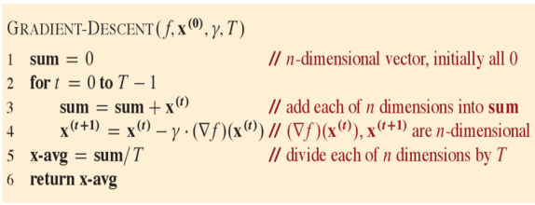

Slide 6
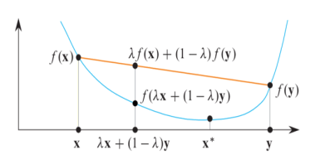
Convex functions
Convex function is where a function f: R^{n} -> R for all x,y ∈ R^{n} and for all 0 ≤ λ ≤ 1
f(λx + (1 – λ)y) ≤ λf(x) + (1-λ)f(y)
We assume our convex functions are closed and differentiable
Figure 2. A convex function f : R ➔ R, shown in blue, with local and global minimizer x*. Because f is convex f(λx + (1 – λ)y) ≤ λf(x) + (1-λ)f(y) for any two values x and y and all 0 ≤ λ ≤ 1, shown for a particular value of λ. Here, the orange line segment represents all values λf(x) + (1+ λ)f(y) for 0 ≤ λ ≤ 1, and it is above the blue line.

Slide 7
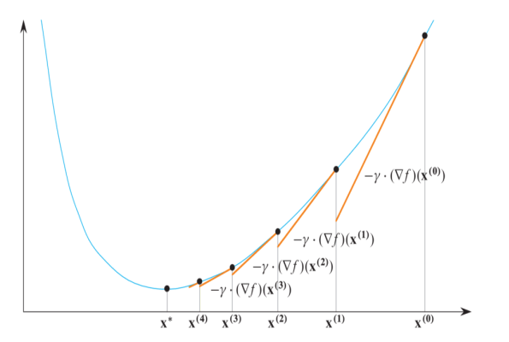
GD in convex
Figure 3. An example of running gradient descent on a convex function f: R➔R, shown in blue. Beginning at point x^{(O)}, each iteration moves in the direction opposite to the gradient, and the distance moved is proportional to the magnitude of the gradient. Orange lines represent the negative of the gradient at each point, scaled by the step size γ. As the iterations proceed, the magnitude of the gradient decreases, and the distance moved decreases correspondingly. After each iteration, the distance to the optimal point x* decreases.

Slide 8
Local min is global min
Use contradiction: x is local but not global minimum and y ≠ x, f(y) < f(x)
f(λx + (1 – λ)y) ≤ λf(x) + (1- λ)f(y)
< λf(x) + (1- λ)f(x)
= f(x)
Thus, letting λ approach 1, we see there is another point near x, say x’, such that f(x’) < f(x), so x is not local min

Slide 9
GD analysis
We use error bound ∈ so that f(xavg) – f(x*) ≤ ∈, x* is global min
R = ∥ x⁽⁰⁾ – x*∥
∥(∇f)(x) ∥ ≤ L
Theorem 33.8: Let x* ∈ R^{n} be the minimizer of a convex function f and suppose that an execu­tion of GRADIENT-DESCENT(f,x⁽⁰⁾,γ,T) returns xavg , where γ = R/(L√T) and R and L are defined above. Let ∈ = RL/√T. Then we have f(x-avg) - f(x*) ≤ ∈.

Slide 10
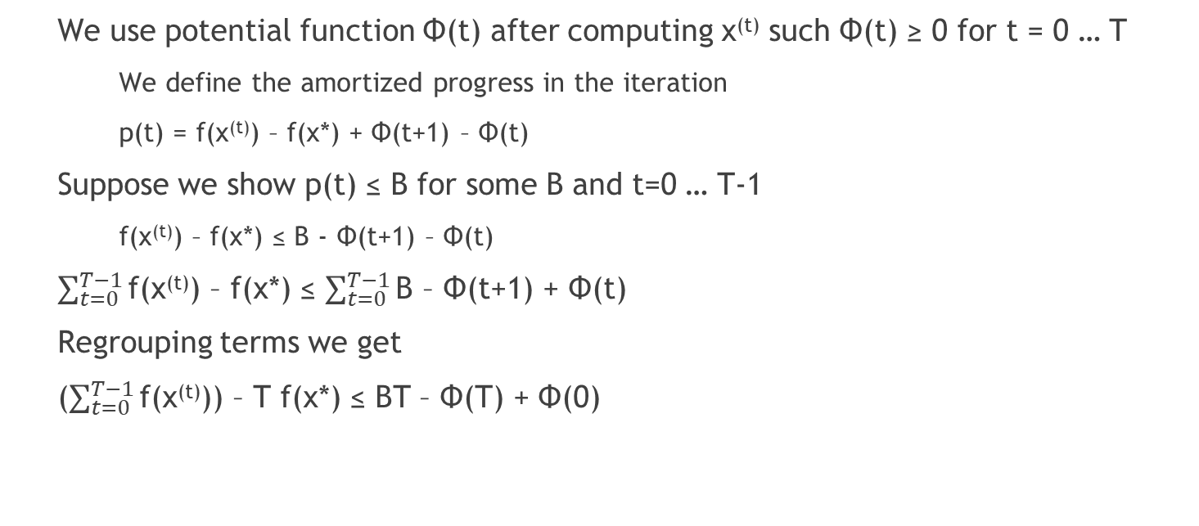
Theorem 33.8 proof
We use potential function Φ(t) after computing x^{(t)} such Φ(t) ≥ 0 for t = 0 … T
We define the amortized progress in the iteration
p(t) = f(x^{(t)}) – f(x*) + Φ(t+1) – Φ(t)
Suppose we show p(t) ≤ B for some B and t=0 … T-1
f(x^{(t)}) – f(x*) ≤ B - Φ(t+1) – Φ(t)
$\sum_{t=0}^{T−1}{\text{f}\text{(}\text{x}\text{(}\text{t}\text{)) – }\text{f}\text{(}\text{x}\text{*)}}$ ≤ $\sum_{t=0}^{T−1}{\text{B}\text{ – }\text{Φ}\text{(}\text{t}\text{+1) + }\text{Φ}\text{(}\text{t}\text{)}}$
Regrouping terms we get
($\sum_{t=0}^{T−1}{\text{f}\text{(}\text{x}\text{(}\text{t}\text{))}}$) – T f(x*) ≤ BT – Φ(T) + Φ(0)

Slide 11
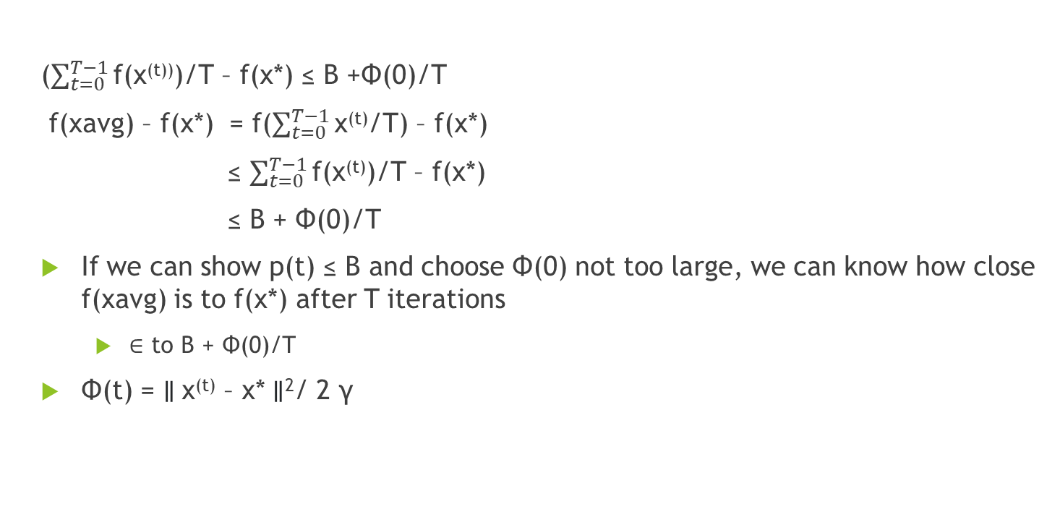
Theorem 33.8 proof
($\sum_{t=0}^{T−1}{\text{f}\text{(}\text{x}\text{(}\text{t}\text{))}}$)/T – f(x*) ≤ B +Φ(0)/T
f(xavg) – f(x*) = f($\sum_{t=0}^{T−1}{\text{x}\text{(}\text{t}\text{)}}$/T) – f(x*)
≤ $\sum_{t=0}^{T−1}{\text{f}\text{(}\text{x}\text{(}\text{t}\text{)}}$)/T – f(x*)
≤ B + Φ(0)/T
If we can show p(t) ≤ B and choose Φ(0) not too large, we can know how close f(xavg) is to f(x*) after T iterations
∈ to B + Φ(0)/T
Φ(t) = ∥ x^{(t)} – x* ∥²/ 2 γ

Slide 12
Lemma 33.9
Let x* ∈ R^{n} be the minimizer of a convex function f and consider an execution of GRADIENT-DESCENT(f, x⁽⁰⁾,γ,T). Then for each point x^{(t)} computed by the procedure, we have that
p(t) = f(x^{(t)}) - f(x*) + Φ(t + 1) - Φ(t) ≤ (γ L²)/2

Slide 13
GD analysis
If we have a target ∈ then we can compute the number of iterations needed
∈ = RL/√T solve for T, gives T = R²L²/∈²
We don’t know R and L since we would need to know x*
This proves that there exists some step size for the procedure to make progress toward the minimum

Slide 14
Line search
Binary search like routine to search for a step size that achieve large decrease
g(x^{(t)},s) ≤ f(x^{(t)}) – s(∇f) (x^{(t)}) for function f and step size s
Start with g(x^{(t)},s) ≤ f(x^{(t)}) then double s until g(x^{(t)},2s) ≥ g(x^{(t)},s) and perform binary search in the interval [s,2s]
The complexity of computing and evaluating a gradient varies widely depending on the application at hand

Slide 15
Conclusion
Learned about unconstrained GD
The local min of a convex function is also the global minimum
We can use ∈ to decide how close we want to be to the global minimum
Use line search to find ideal step size

